Slide 1
Hierarchical Temporal Memory (HTM)
Introduction and applications
Joy Bose

Slide 2
Problem with classical AI research
AI research, especially deep learning, has got impressive results in many fields
But they have not been able to replicate human learning and intelligence
Systems require enormous time and resource to train, are brittle to noise, cannot learn continuously, and do not generalize but rather accomplish narrow, specific goals. We are still a long way from a robot performing tasks that a child can handle easily.
The main mistake is not understanding how the human brain learns and, instead, treating the brain as a computer that could be programmed to produce intelligent behavior.
Biologically inspired Vs biologically constrained
Deep learning requires custom training in batch mode for specific tasks and does not continuously learn like the brain.
AI models developed were only good at the particular task for which they were designed. The programs did not have the ability to generalize: did not have a unified theory of intelligence
Proposed solution (by Jeff Hawkins): Use biology of the brain as guidance while thinking about learning as an algorithmic problem with a solution implementable on computers

Slide 3

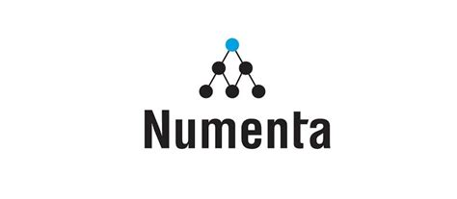
Background: What is Intelligence?
Neural Networks and the field of artificial intelligence try to replicate (or inspired by) human intelligence. But what is intelligence?
Data Science / machine learning has a lot to learn from neuroscience
Jeff Hawkins (inventor of Palm Pilot) tried to explore the answer using insights from Neuroscience
Wrote a seminal book “On Intelligence” in 2004.
Key Insight: Intelligence is the ability to make probabilistic predictions of what is going to happen (not behavior)
Founded a company called Numenta to implement and commercialize the insights from the book

Slide 4
How does the brain work?
There is no unifying theory of how intelligence works
Computer scientists: build higher level models
Neuroscientists: build detailed models of each small part of the brain
Vision, speech, hearing, motor -> similar structure
Neocortex
Part of brain responsible for intelligence
How neocortex works = how intelligence works
Neocortex has 6 stacked layers of neurons : arranged in hierarchies communicating via spikes
Each layer simultaneously generates predictions, predictions from higher layers are sent back to lower layers
Intuition: if we come back to our office desk and something has changed, we notice it immediately

Slide 5
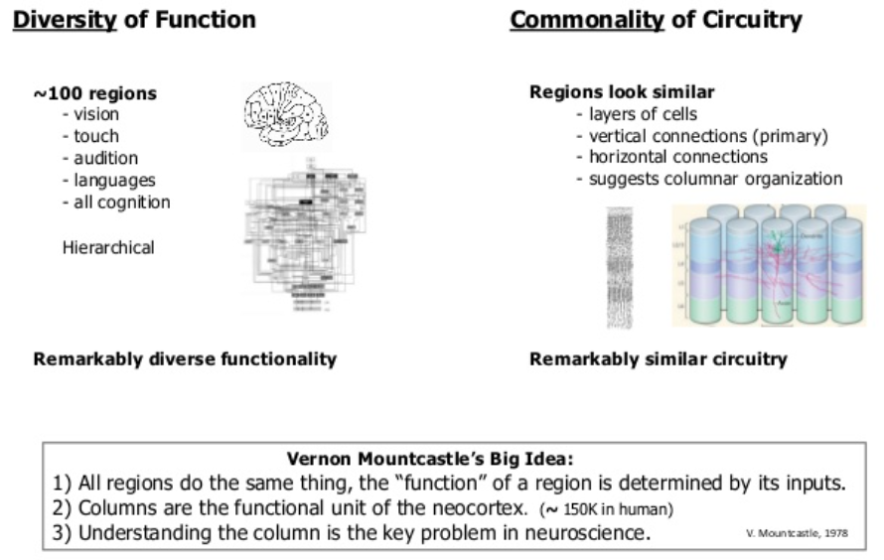
Vernon Mountcastle’s 1978 idea

Slide 6
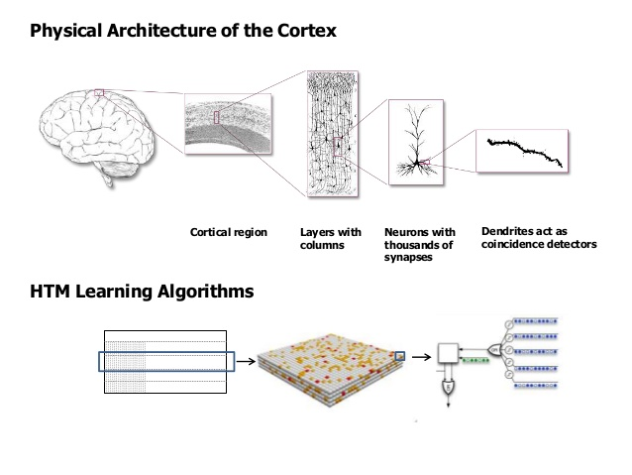
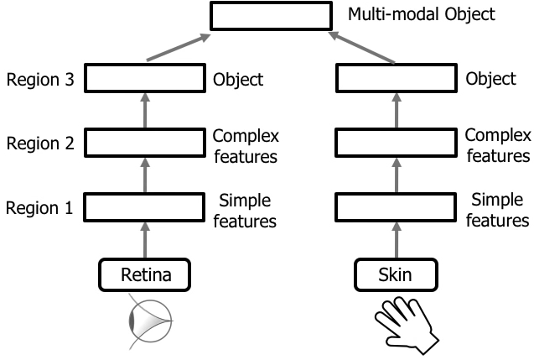
How does the brain work?

Slide 7
Memory prediction framework (from the book)
The neocortex is constructing a model for the spatial and temporal patterns that it is exposed to. The goal of this model construction is the prediction of the next pattern on the input.
Replicates a basic computational unit , a node that is replicated several times.
Organized as a hierarchy. Nodes – the basic computational units – are connected in a tree shaped hierarchy.
Function → model the world that it is exposed to. This model is built using a spatial and temporal hierarchy by memorizing patterns and sequences at every node of the hierarchy. This model is then used to make predictions about the input.
Builds its model of the world in an unsupervised manner.
Each node in the hierarchy stores a large number of patterns and sequences.
The output of a node is in terms of the sequences of patterns it has learned.
Information is passed up and down in the hierarchy to recognize and disambiguate information and propagated forward in time to predict the next input pattern

Slide 8
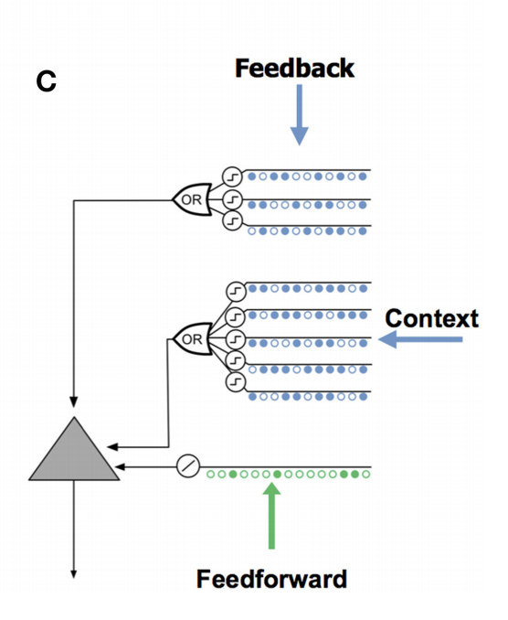
HTM features (also features of neocortex)
Stores sequences of patterns
Stores and recalls patterns auto associatively (part of / noisy pattern can retrieve original pattern)
Has feedback loops
Stores patterns in invariant form
Hierarchical structure (as per the connections, not physical location)
Learns both spatial and temporal patterns
Sparse distributed representations
Continuous learning
Makes probabilistic predictions
Learning is unsupervised
One shot learning
Combines information from different sources
Contextual learning: context is important
No hyperparameter tuning needed

Slide 9
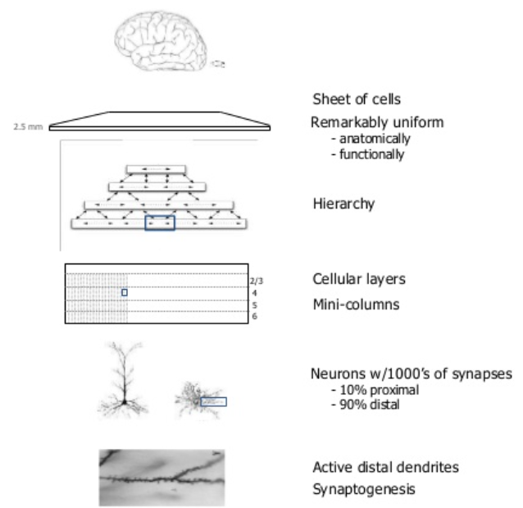
HTM features (also features of neocortex)

Slide 10
Abstract representation
Context
SDR
Predicted
Output
(stream
of data)
Encoder
Spatial Pooling
Temporal Memory
Input
(stream
of data)
Sequence
of SDRs

Slide 11
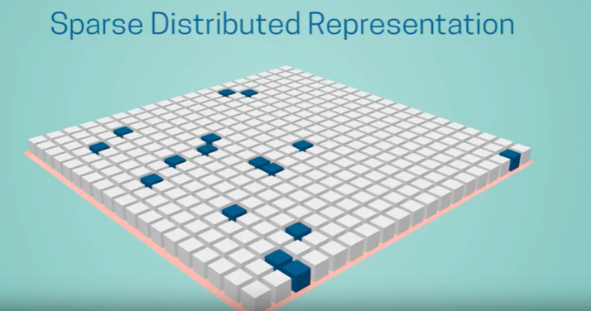
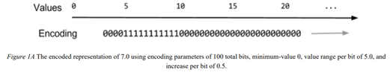
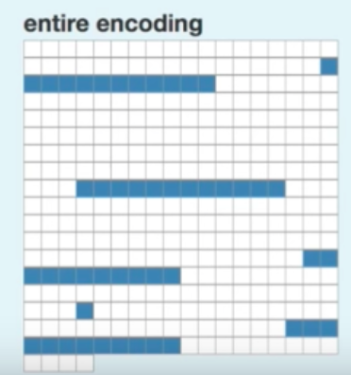
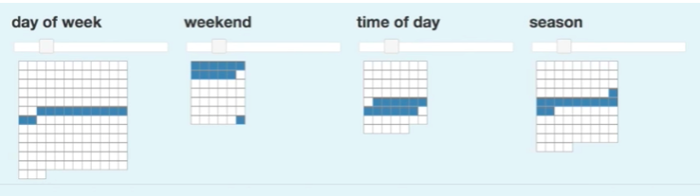
How it works: Encoding
Encode the data: Sparse Distributed Representations (SDRs). Feed the encoded data to HTM
Binary
lots of zeros, few 1s (less than 2%)
each bit has semantic meaning
Sparse = only a few neurons are active
data structure of the brain
Overlap score between 2 SDRs: measure of similarity
Human cochlea: each cell responds to overlapping frequency range
Semantically similar data → SDRs with overlapping active bits.
Same input → same SDR as output.
Output should have the same dimensionality (total number of bits) for all inputs.
The output should have similar sparsity for all inputs and have enough one-bits to handle noise and subsampling.

Slide 12
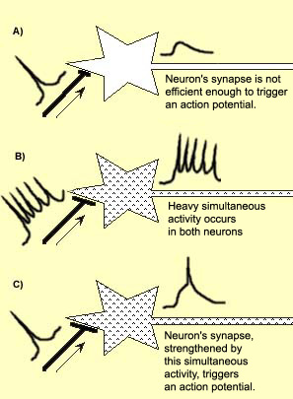
Hebb’s rule and Hebbian learning
When an axon of cell A is near enough to excite a cell B and repeatedly or persistently takes part in firing it, some growth process or metabolic change takes place in one or both cells such that A's efficiency, as one of the cells firing B, is increased
“Cells that fire together wire together”
w(i,j) = x(i) x(j)

Slide 13
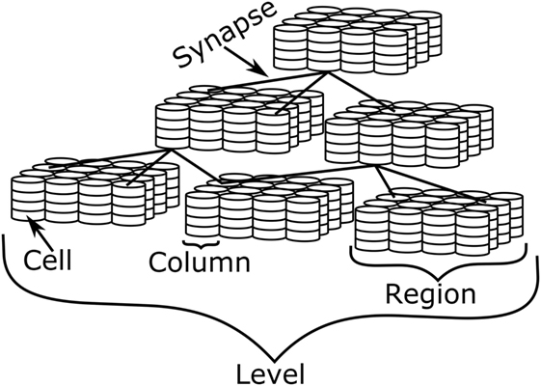
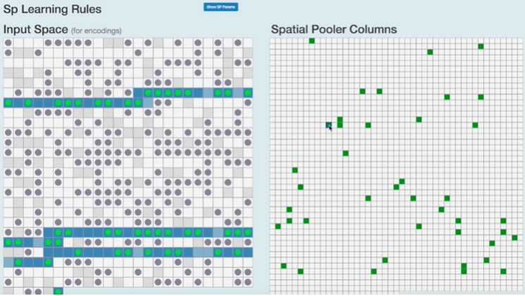
How it works: Spatial Pooling
Accepts the input vector of different sizes, represents it into sparse vectors of same size.
Translates the input data into active columns
The output of the Spatial Pooler represents the mini columns i.e the pyramidal neuron in the cortices.
Hebbian style learning (in active columns)
Learning → establishing connections, or synapses, between cells
For each active column, we adjust the permanence values of all the potential synapses (connected to active inputs).
The permanence values of synapses aligned with active input bits are increased.
The permanence values of synapses aligned with inactive input bits are decreased.
Boosting and inhibition: only the winner columns can update their permanence values

Slide 14
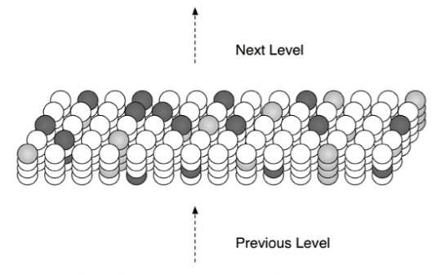
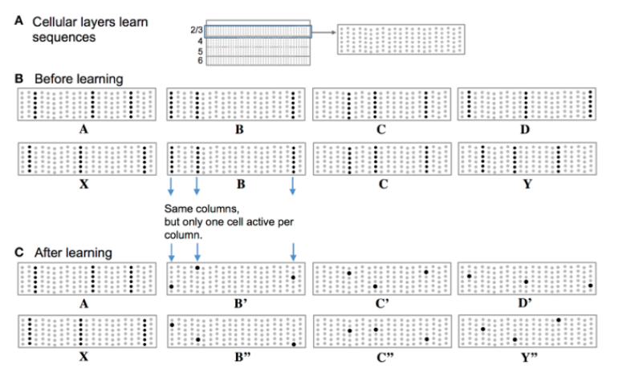
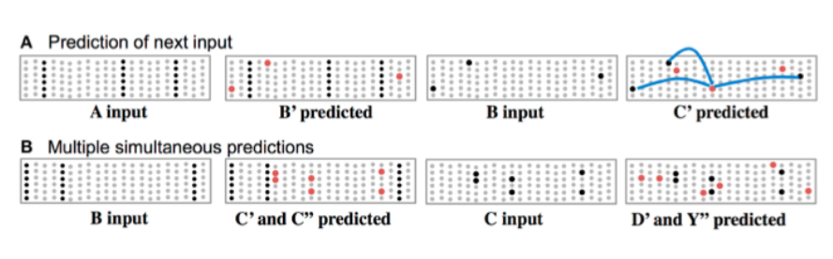
How it works: Temporal Memory
Learn the temporal patterns (sequences) of SDRs from the spatial pooling algorithm and predicts the next SDRs
Form a representation of the input in context of previous inputs
Temporal Memory algorithm converts the columnar representation of the input into a new representation that includes state, or context, from the past.
The new representation is formed by activating a subset of the cells within each column, typically only one cell per column
At any point in time, some cells in an HTM layer will be active due to feed-forward input (shown in light gray). Other cells that receive lateral input from active cells will be in a predictive state (shown in dark gray).

Slide 15
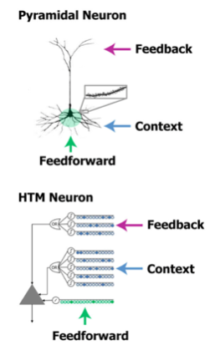
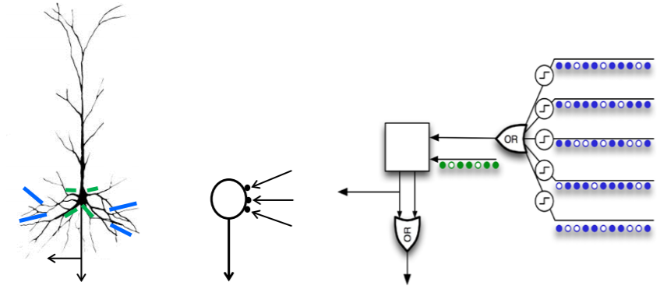
Biological neuron, ANN, HTM

Slide 16
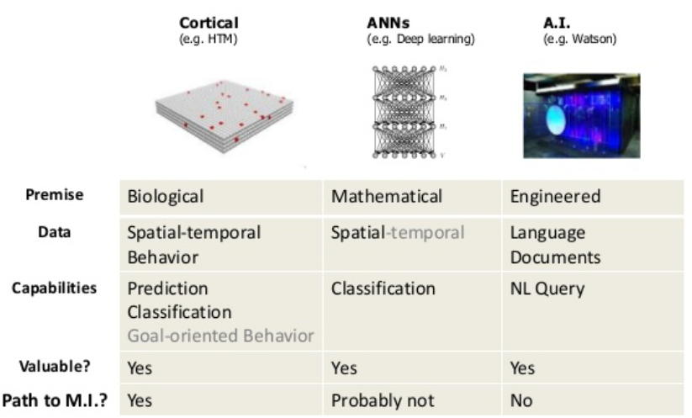
HTM vs RNN
Similarity
HTMs are good for sequence learning (like RNNs, LSTMs)
Differences of HTM and RNNs :
HTMs have a more complex neuron model
HTMs do not employ back-propagation and minimizing loss function but a simple (and local) unsupervised hebbian-learning rule
HTMs are based on very sparse activations and neuron connectivity
HTMs are based on binary units and weights.
No separation between training and testing
Works on streamed data

Slide 17
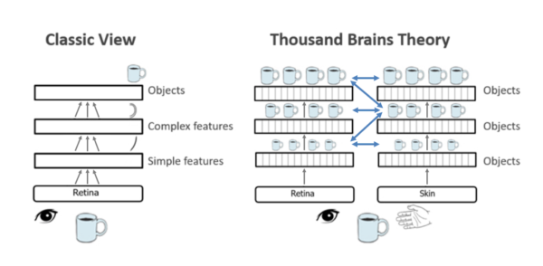
Thousand Brains Theory
The neocortex consists of thousands of models operating in parallel as well as hierarchically. Rather than learning one model of the world, every part of the neocortex learns complete models of objects and concepts.
Long range connections in the neocortex allow the models to work together to create your perception of the world.
2019 Frontiers in Neural Circuits paper “A Framework for Intelligence and Cortical Function Based on Grid Cells in the Neocortex”

Slide 18
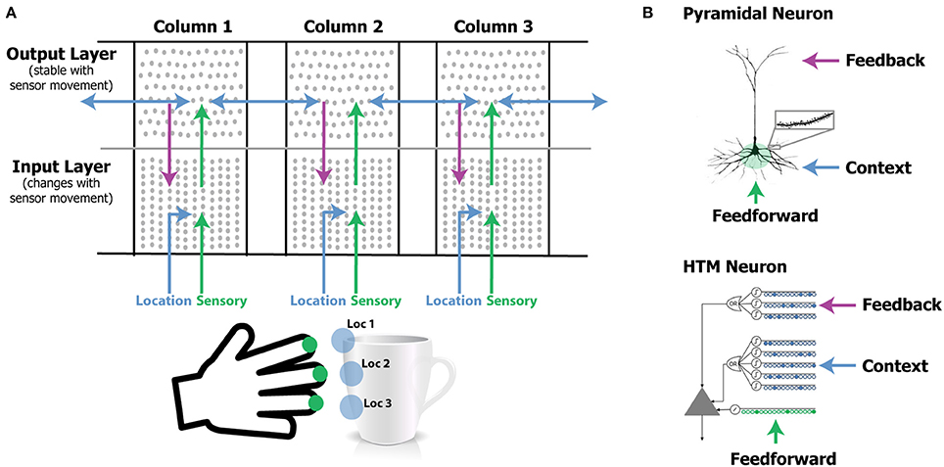
How HTMs work

Slide 19
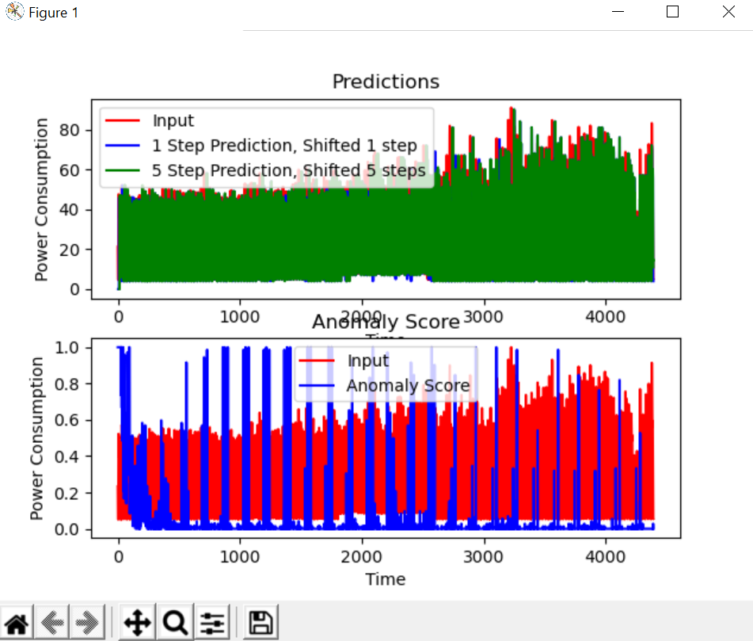
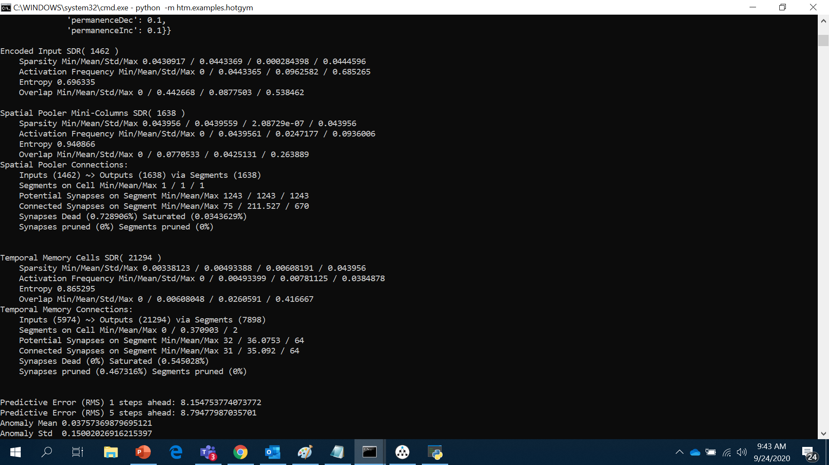
How to use it
NUPIC (open source: no python3 support, only python 2.7)
https://github.com/numenta/nupic https://github.com/numenta/nupic/blob/master/examples/NuPIC%20Walkthrough.ipynb
HTM core (community project) python -m pip install -i https://test.pypi.org/simple/ htm.core
https://github.com/htm-community/htm.core
Sample application: python -m htm.examples.hotgym
https://github.com/topics/hierarchical-temporal-memory
Sequence learning code: https://3rdman.de/2020/02/hierarchical-temporal-memory-part-1-getting-started/ and https://3rdman.de/2020/04/hierarchical-temporal-memory-part-2/

Slide 20
What HTMs can do: Applications
Discover causes in the world: learns the HTM from some data. Present data and some algorithm finds common patterns in the low-level measurements and assumes they were produced by some high-level cause. This knowledge is captured in the HTM
Infer causes of novel input: determine which high-level object caused some new measurements. You feed in the measurements at the bottom layer of the HTM, calculations are performed, and the HTM tells you the most likely object that causes them.
Make predictions: predict what measurements are most likely to be obtained next
Direct behavior: control some physical system (like a robot).
https://numenta.com/machine-intelligence-technology/applications/
Code: https://github.com/numenta/numenta-apps

Slide 21
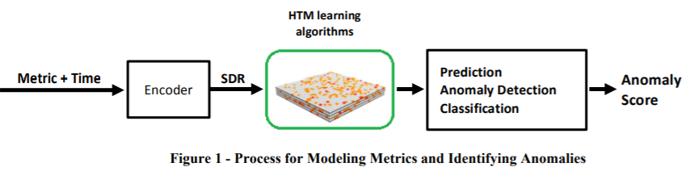
Application: Anomaly detection in streaming data
Build a separate model for each metric being monitored
The metric value is combined with a time stamp
The metric value and time are fed to an encoder that converts them into a sparse distributed representation (SDR)
A sequence of SDRs is fed into the HTM learning algorithms for learning temporal sequences in the server metric data streams
if a new pattern is different but similar to previously learned patterns, the HTM learning algorithms will make an appropriate prediction in the same way you make predictions when hearing a new melody for the first time.
Existing anomaly detection (ARIMA etc) don’t catch subtle or slow changes in patterns
White paper: https://numenta.com/assets/pdf/whitepapers/Numenta%20White%20Paper%20-%20Science%20of%20Anomaly%20Detection.pdf

Slide 22
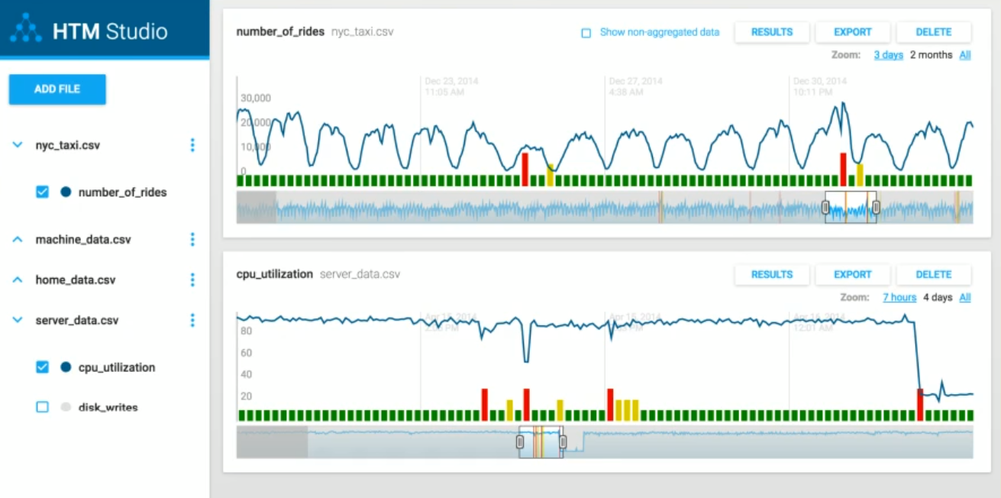
Application: HTM studio
https://numenta.com/machine-intelligence-technology/htm-studio/ (download exe and upload your data file to find anomalies)
Test whether our Hierarchical Temporal Memory (HTM) algorithms will find anomalies in your data

Slide 23
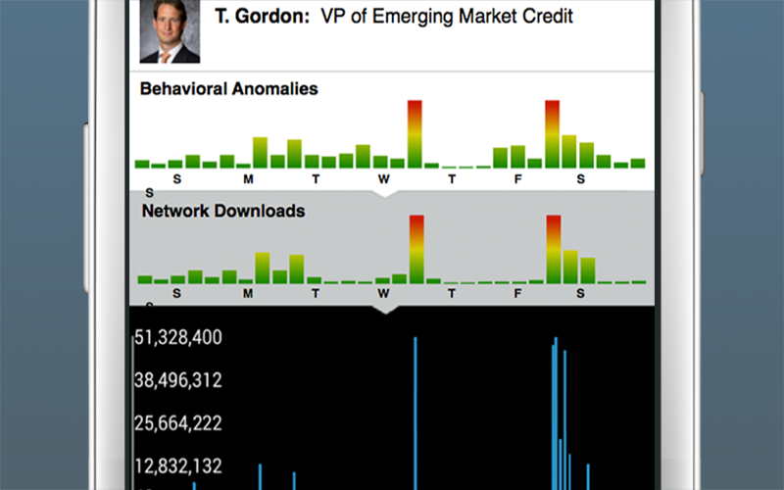
Application : Rogue Behavior Detection
Detects changes in behavior of individuals, such as unusual use of files

Slide 24
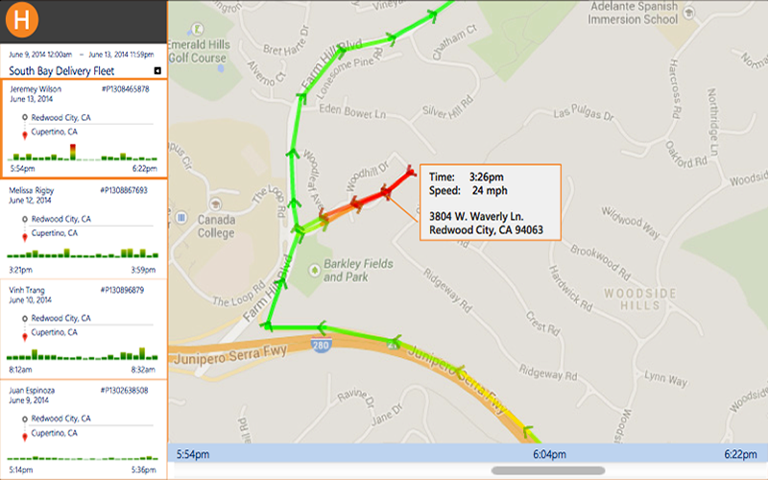
Application: Geospatial tracking
Highlighting anomalies in the behavior of moving objects, such as tracking a fleet’s movements on a truck by truck basis
Geospatial Tracking: anomalies in the movement of people, objects using speed and location data

Slide 25
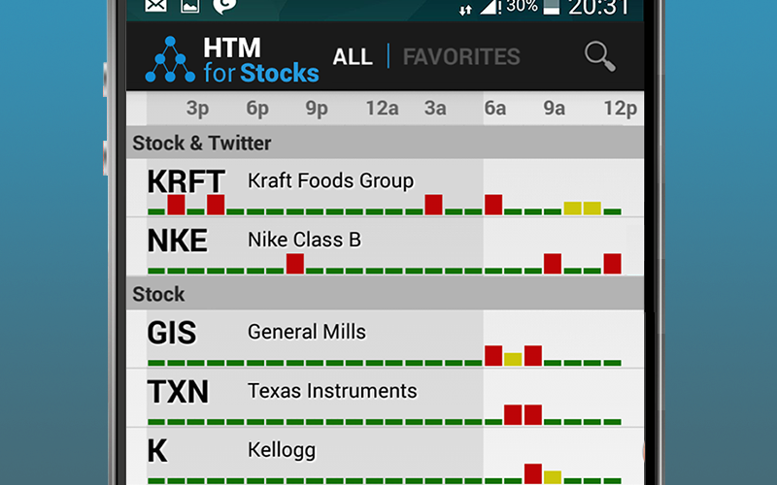
Application: HTM for stocks
Detects anomalies in publicly traded companies. It continuously models stock price, stock volume

Slide 26
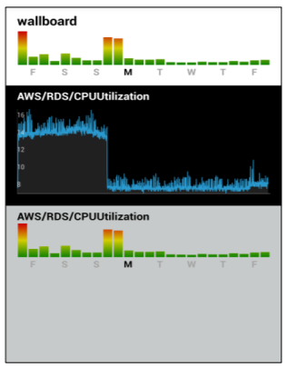
Application: Anomaly detection in streaming data: server monitoring

Slide 27
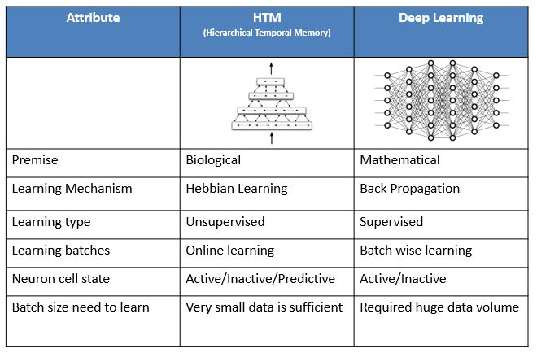
HTM vs Deep Learning

Slide 28
Summary
Introduction and history of HTMs: neuroscience background
Theory of HTMs: SDRs, spatial pooling, temporal memory, thousand brains theory
Some applications of HTM: anomaly detection with HTM studio
Python libraries (nupic, htm.core) ,sample code and how to use it

Slide 29
References
https://numenta.com/blog/2019/10/24/machine-learning-guide-to-htm
Jeff Hawkins et al, A Framework for Intelligence and Cortical Function Based on Grid Cells in the Neocortex, Neural Circuits 2019 https://www.frontiersin.org/articles/10.3389/fncir.2018.00121/full
HTM white paper https://numenta.com/neuroscience-research/research-publications/papers/hierarchical-temporal-memory-white-paper/
https://github.com/numenta/nupic
NUPIC walkthrough https://nbviewer.jupyter.org/github/numenta/nupic/blob/master/examples/NuPIC%20Walkthrough.ipynb
https://github.com/topics/hierarchical-temporal-memory

